Slide 1
𝐃𝐈𝐆𝐈𝐓𝐀𝐋 𝐏𝐎𝐑𝐓𝐅𝐎𝐋𝐈𝐎
Name : Yamini. N Reg.no. : 36324u18075 Department : B.sc ( computer science)
College : sree abiraami arts and science College
for women University : Thiruvallur University Email.id. :.yamininavya2007@gmail.com

Slide 2
PROJECT TITLE
Problem Statement Project Overview End Users Tools and Techniques Portfolio design and Layout Features and Functionality Results and Screenshots Conclusion Github Link

Slide 3

PROBLEM STEATMENT
In today’s digital era, Traditional resume alone are not enough shower case skill and projects effectively . Many students and professional lack a structured online presence to highlight their work. A digital portfolio Provides an interactive and accessible

Slide 4
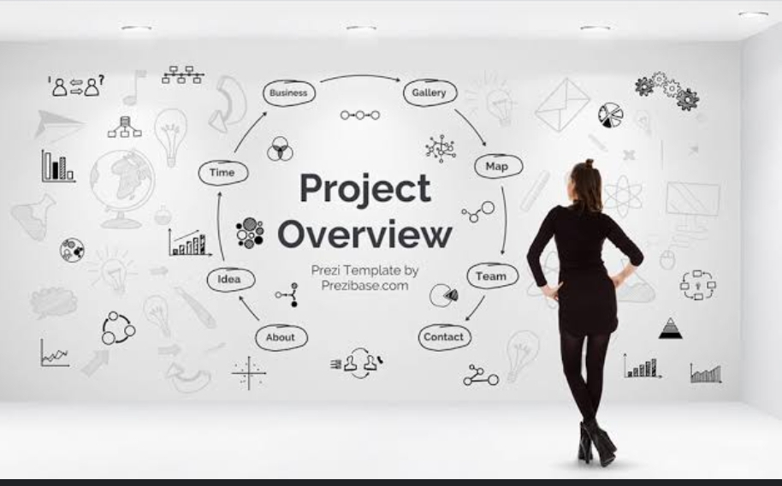
PROJECT OVERVIEW
Brief summary of your project. What your portfolio contains (About Me, projects, Contact ). Main idea : Showcase personal achievements, skills and Projects.

Slide 5
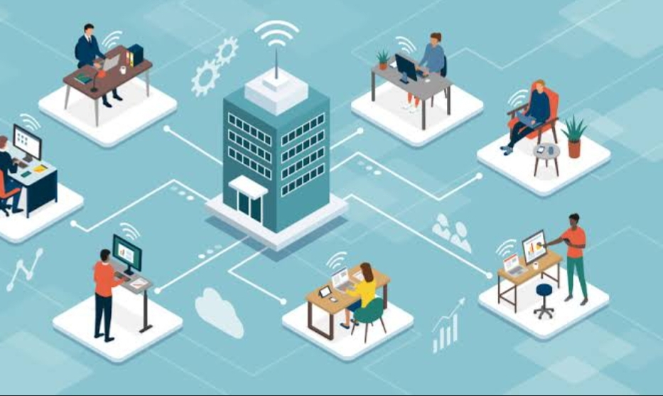
END USERS
Students ( academic projects, resume ). Job seekers ( to share with recruiting . Freelance(to share with clients). Professional (to highlights experience and achievements).

Slide 6

TOOLS AND TECHNIQUES
HTML – structure (pages, sections ). CSS – Styling (colours, layouts, responsiveness ). JavaScript – Inactively ( navigation menu, animations, from validation ). Mentione cod editor – ( VS code) or CODEPE hosting and platform (GitHub pages).

Slide 7
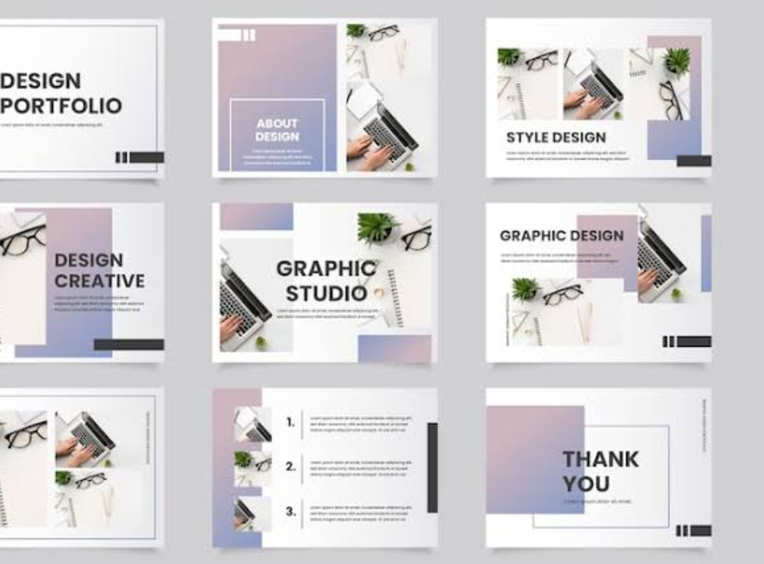
PORTFOLIO DESIGN AND LAYOUT
About Me Skills Projects /Work Samples Resumes /achievement Contact

Slide 8

FEATURES AND FUNCTIONALITY
User Registration & Login – Secure account creation and access. Profile Management – Add personal details, bio, and contact information. Resume Upload / Builder – Upload or create a professional CV. Project Showcase – Display academic, professional, or creative projects with descriptions, images, or videos. Certificates & Achievements – Upload certifications, awards,

Slide 9

RESULTS AND SCREEN SHORT
About Me: I am Swetha. U passionate developer focuse on respective design and front End technologies. Skills: About Me: I am Swetha. U passionate developer focuse on respective design front End technologies. Skills : Certificate :A national level conference about AI 1.HTML 2.CSS 3.JavaScript 4.Python 5.C++

Slide 10

CONCLUSION
The Digital Portfolio serves as an innovative and effective solution for showcasing individual skills, achievements, and experiences in a professional manner. Unlike traditional resumes, it provides an interactive and visually appealing platform where users can present projects.

Slide 11
GiThup
Github Line :
https://github.com/Yamini742007
Portfolio Link:
https://yamini742007.github.io/yaminiporfolio/

